Slide 1

DIGITAL LOGIC DESIGN (111776)
Dr. Owais Hussain

Slide 2

Agenda
Counters
2-bit Async Counter
3-bit Async Counter
4-bit Async Decade Counter
Propagation Delay and Ripple
Sync Counters
Design a Counter
Up/Down Counter

Slide 3
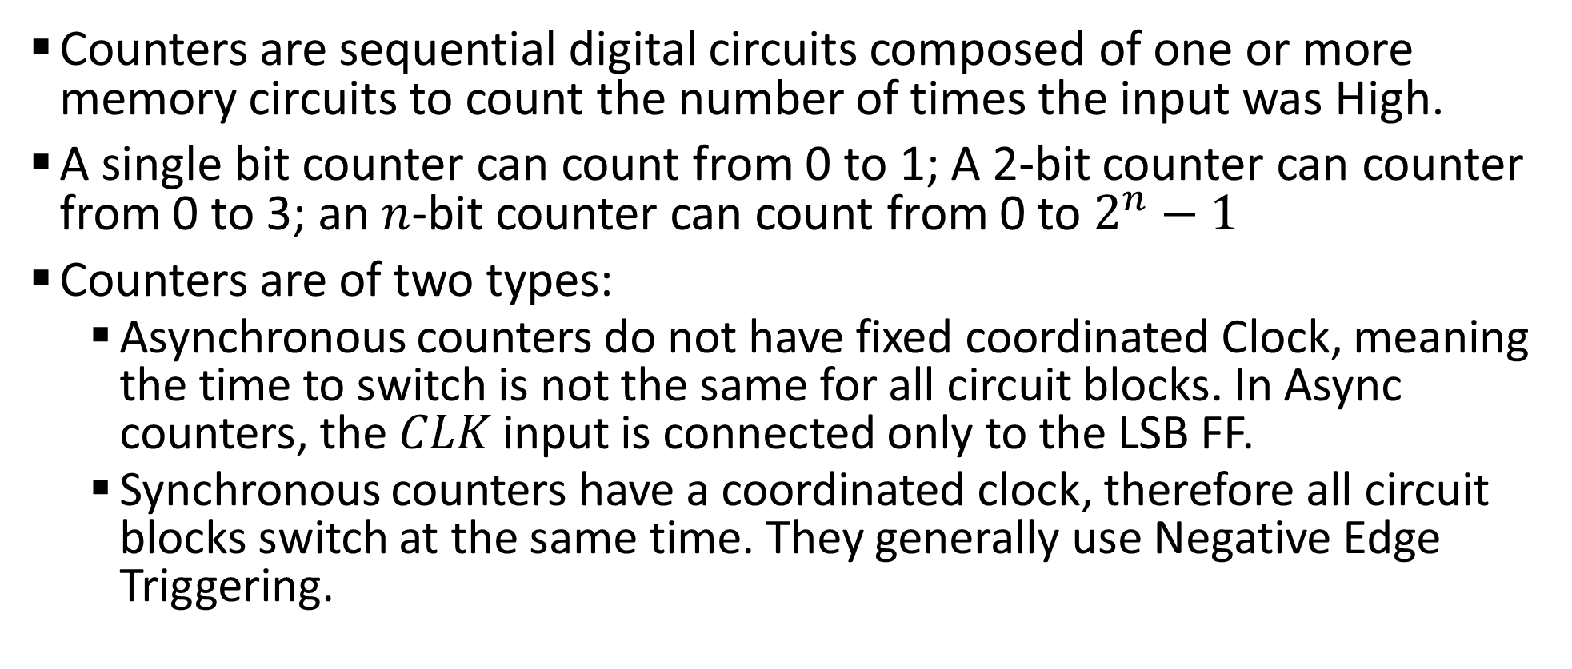
Sample 2
Counters
Counters are sequential digital circuits composed of one or more memory circuits to count the number of times the input was High.
A single bit counter can count from 0 to 1; A 2-bit counter can counter from 0 to 3; an $n$-bit counter can count from 0 to $2^{n}−1$
Counters are of two types:
Asynchronous counters do not have fixed coordinated Clock, meaning the time to switch is not the same for all circuit blocks. In Async counters, the $CLK$ input is connected only to the LSB FF.
Synchronous counters have a coordinated clock, therefore all circuit blocks switch at the same time. They generally use Negative Edge Triggering.

Slide 4
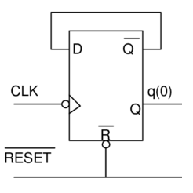
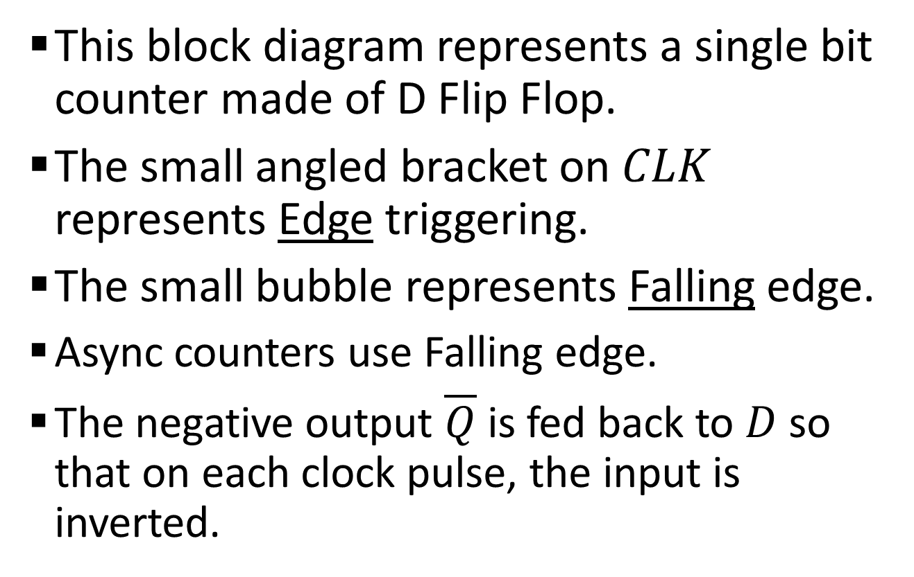
Sample 2
Counters
This block diagram represents a single bit counter made of D Flip Flop.
The small angled bracket on $CLK$ represents Edge triggering.
The small bubble represents Falling edge.
Async counters use Falling edge.
The negative output $\overline{Q}$ is fed back to $D$ so that on each clock pulse, the input is inverted.

Slide 5
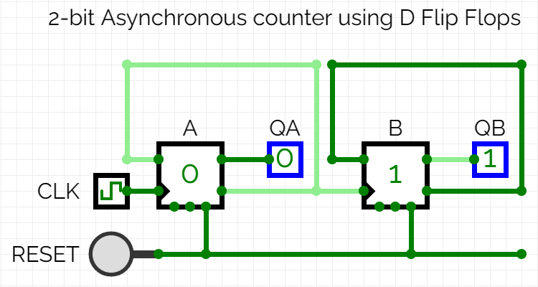
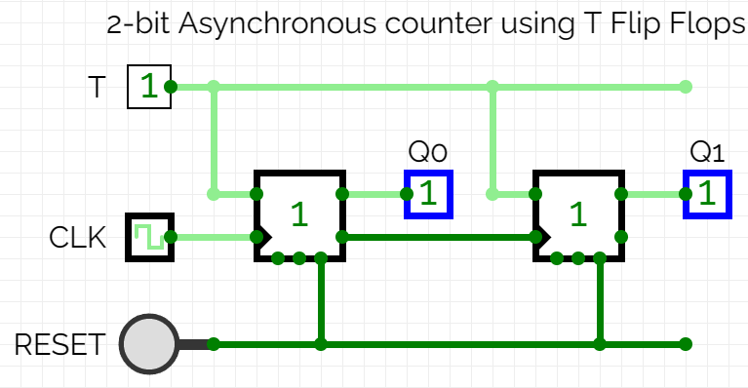
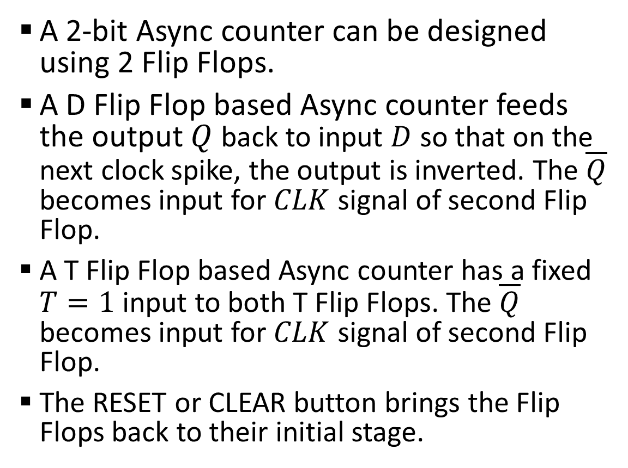
Sample 2
2-bit Async Counter
A 2-bit Async counter can be designed using 2 Flip Flops.
A D Flip Flop based Async counter feeds the output $Q$ back to input $D$ so that on the next clock spike, the output is inverted. The $\overline{Q}$ becomes input for $CLK$ signal of second Flip Flop.
A T Flip Flop based Async counter has a fixed $T=1$ input to both T Flip Flops. The $\overline{Q}$ becomes input for $CLK$ signal of second Flip Flop.
The RESET or CLEAR button brings the Flip Flops back to their initial stage.

Slide 6
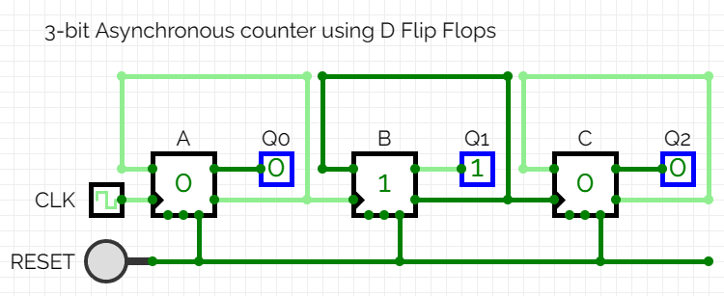
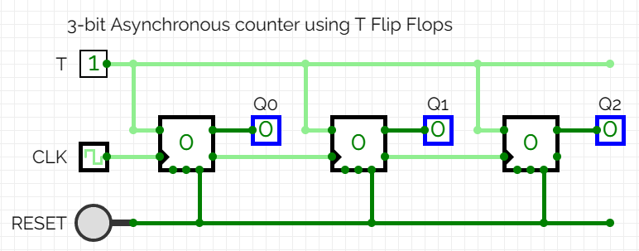
Sample 2
3-bit Async Counter
Extending a 2-bit Async counter to 3-bit counter requires another D Flip Flop and a 3rd output.
Similar approach is taken for a T Flip Flop based counter.

Slide 7
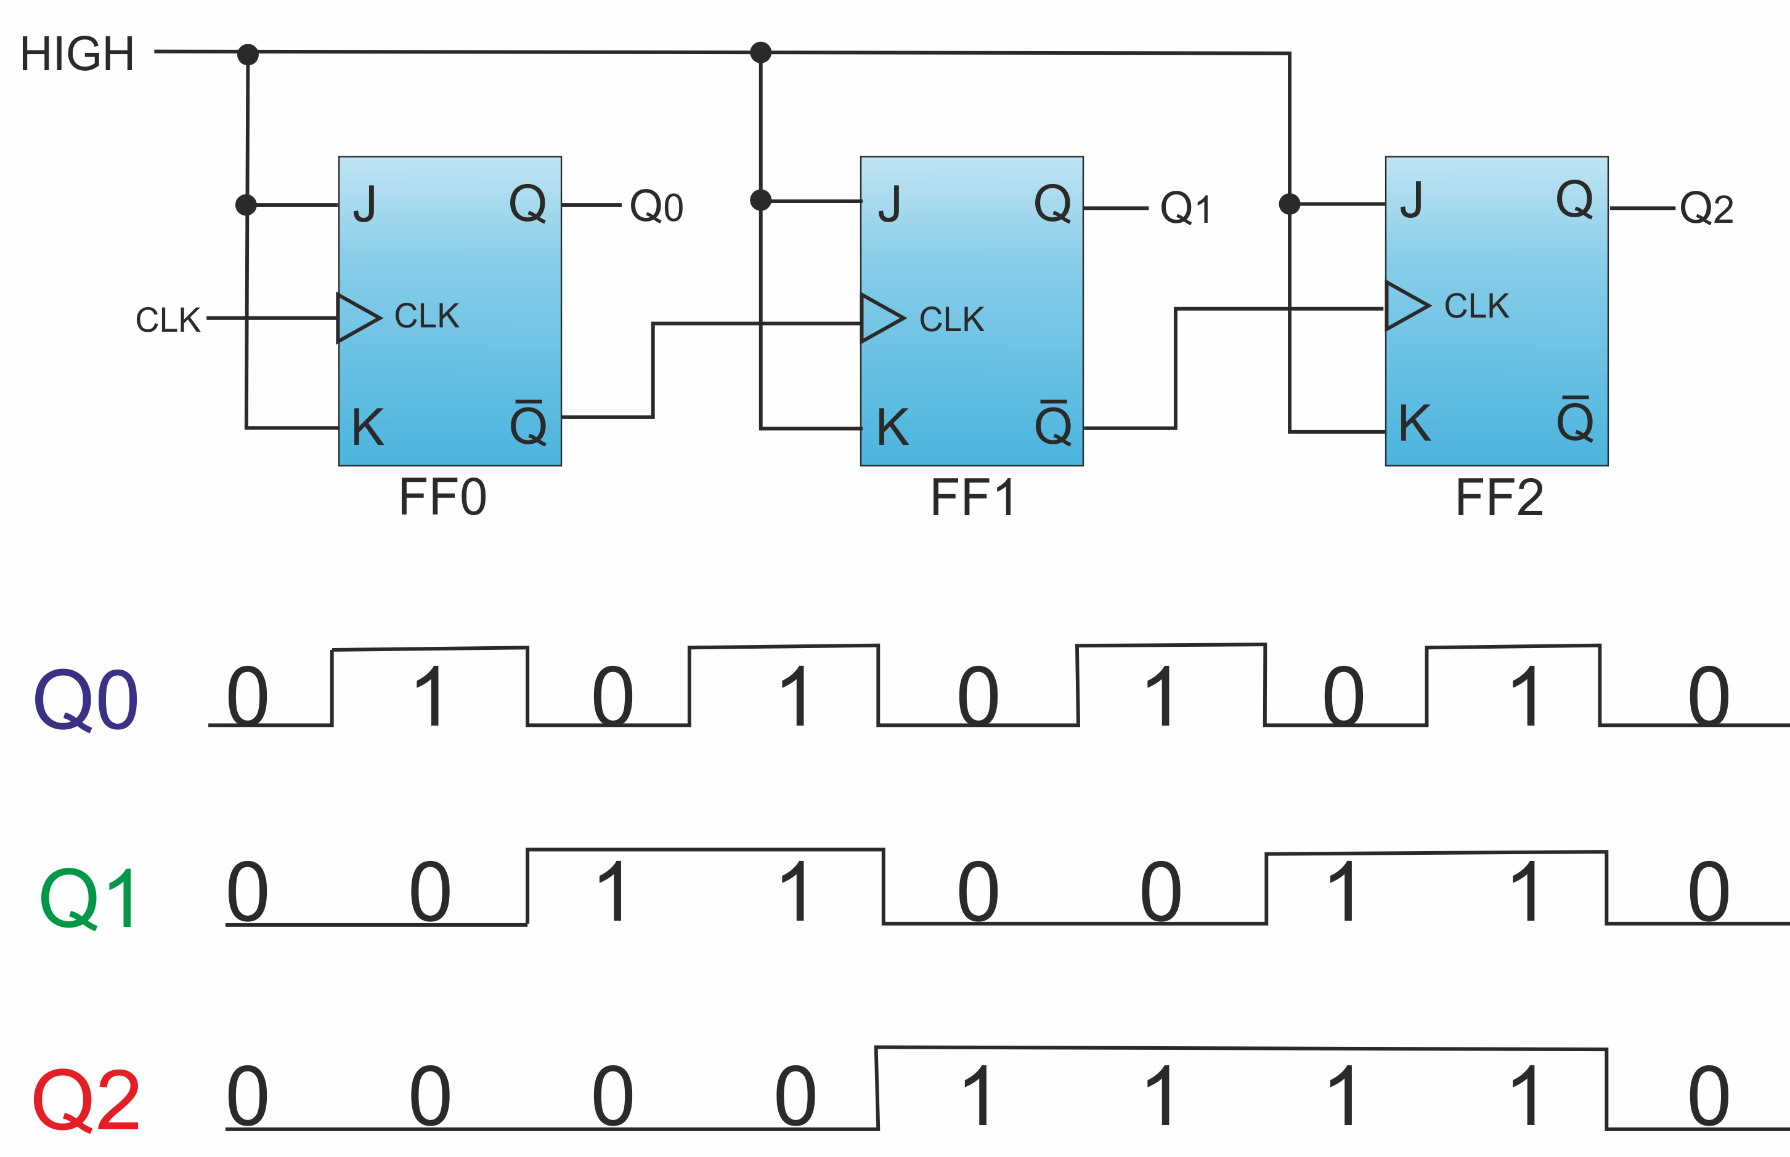
Sample 2
3-bit Async Counter
The waveform of a 3-bit T-FF based Async Counter

Slide 8
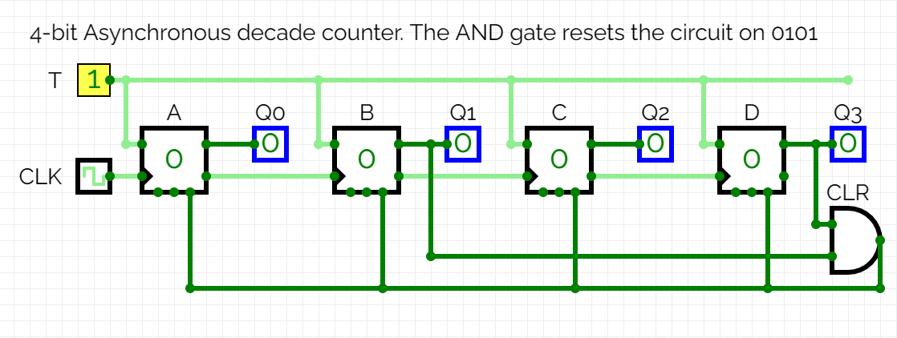
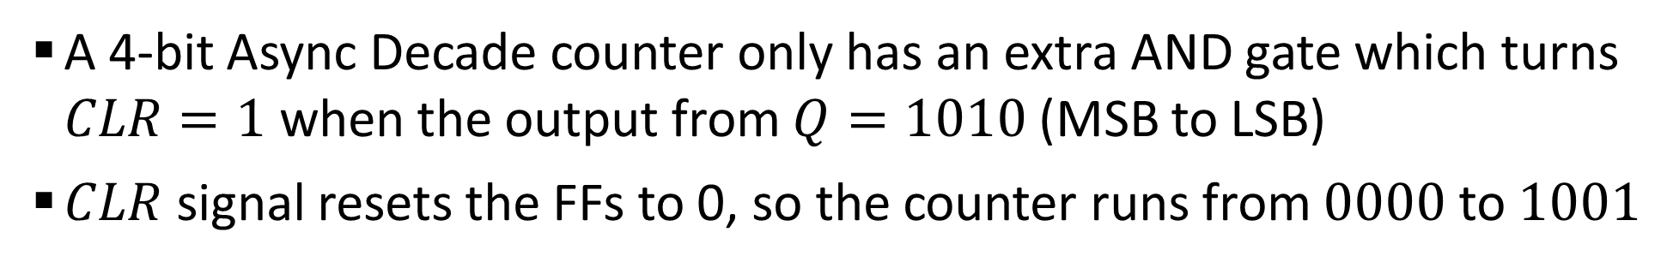
Sample 2
4-bit Async Decade Counter
A 4-bit Async Decade counter only has an extra AND gate which turns $CLR=1$ when the output from $Q=1010$ (MSB to LSB)
$CLR$ signal resets the FFs to 0, so the counter runs from $0000$ to $1001$

Slide 9
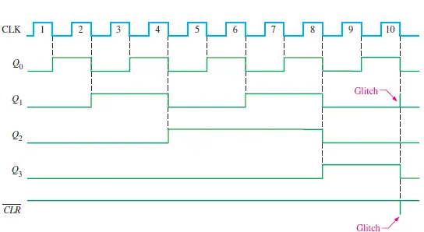
Sample 2
4-bit Async Decade Counter
The waveform of a 4-bit Decade Counter. Glitch represents the pulse where the CLR signal becomes HIGH

Slide 10
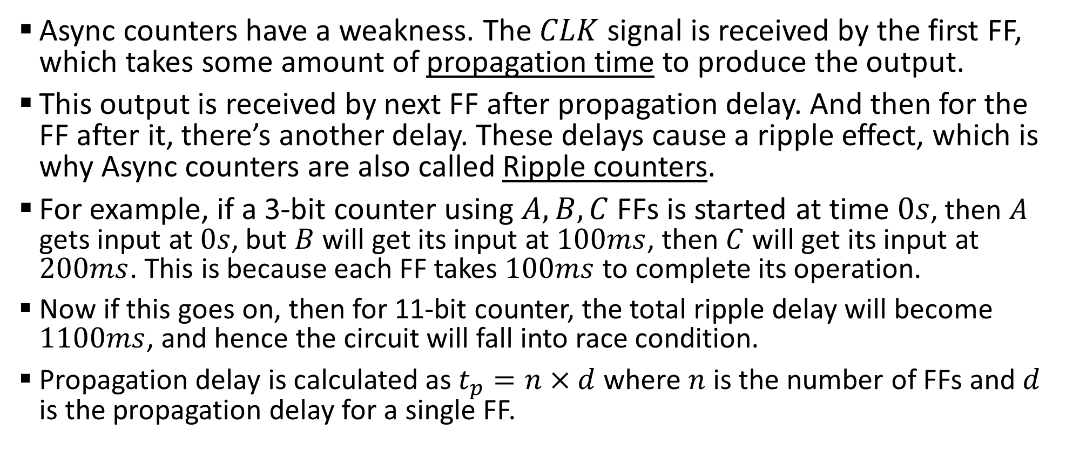
Sample 2
Propagation Delay and Ripple
Async counters have a weakness. The $CLK$ signal is received by the first FF, which takes some amount of propagation time to produce the output.
This output is received by next FF after propagation delay. And then for the FF after it, there’s another delay. These delays cause a ripple effect, which is why Async counters are also called Ripple counters.
For example, if a 3-bit counter using $A,B,C$ FFs is started at time $0s$, then $A$ gets input at $0s$, but $B$ will get its input at $100ms$, then $C$ will get its input at $200ms$. This is because each FF takes $100ms$ to complete its operation.
Now if this goes on, then for 11-bit counter, the total ripple delay will become $1100ms$, and hence the circuit will fall into race condition.
Propagation delay is calculated as $t_{p}=n×d$ where $n$ is the number of FFs and $d$ is the propagation delay for a single FF.

Slide 11
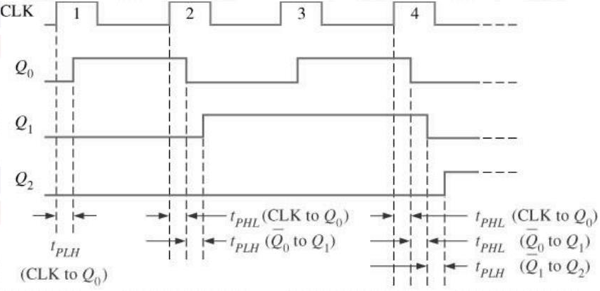
Sample 2
Propagation Delay and Ripple
Waveform of 3-bit Ripple counter, showing propagation delays between triggering.

Slide 12
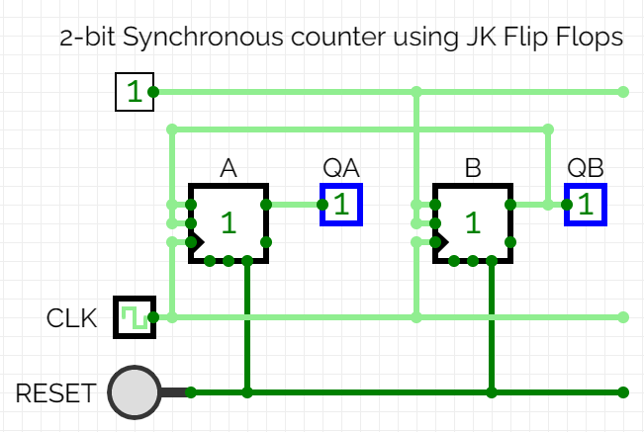
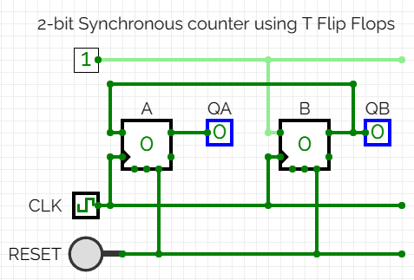
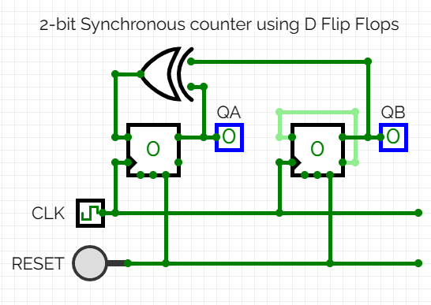
Sample 2
Sync Counter
Sync counters use a common clock pulse for all Flip Flops; there is no propagation delay.
A 2-bit Sync counter can be designed using JK/D/T Flip Flops.
Using JK FFs
Using T FFs
Using D FFs

Slide 13
Sample 2
Designing a Counter
When designing a Sync counter, it is important to follow 6 steps:
Determine the number of FFs to use
Identifying Inputs and Outputs
Create excitation table (complete state table is not required)
Create state diagram from excitation table
Use K-maps to find out simplified equations
Design the circuit diagram
Objective: Design a synchronous counter to count from 0 to 3 using JK Flip Flops.

Slide 14

Sample 2
Designing a Counter
1. Determine the number of FFs to use
The counter will count from 0-3, meaning there will be 4 states.
Since $2^{2}=4$, therefore 2 JK Flip Flops will be required.
Let’s call them $A$ and $B$

Slide 15
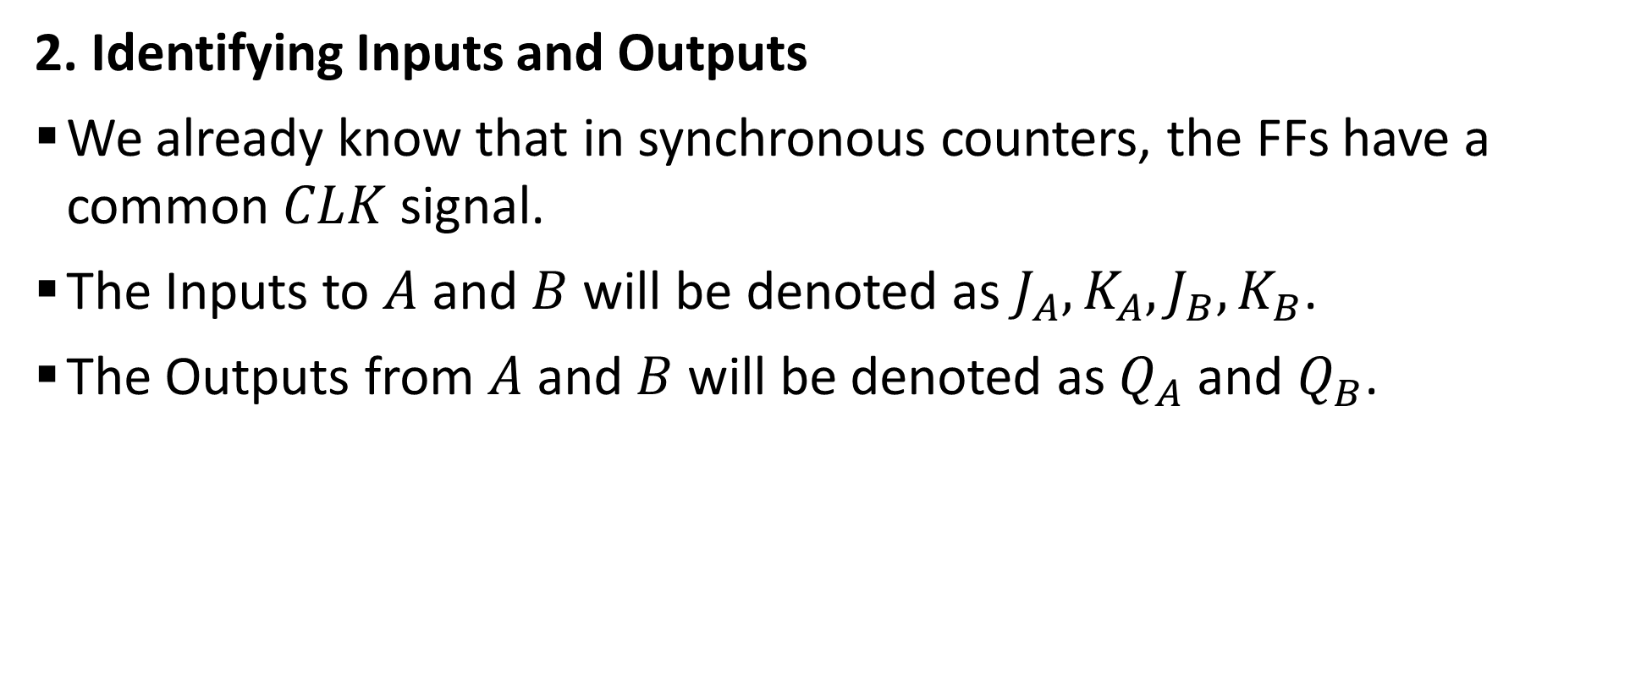
Sample 2
Designing a Counter
2. Identifying Inputs and Outputs
We already know that in synchronous counters, the FFs have a common $CLK$ signal.
The Inputs to $A$ and $B$ will be denoted as $J_{A},K_{A},J_{B},K_{B}$.
The Outputs from $A$ and $B$ will be denoted as $Q_{A}$ and $Q_{B}$.

Slide 16
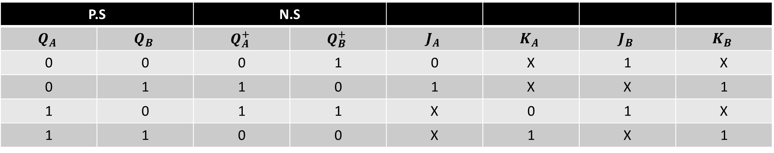
Sample 2
Designing a Counter
3. Create excitation table
In an excitation table, we are interested only in the rows in which P.S and N.S have changed.
We identify what values of inputs are required to transition from P.S to N.S.
P.S |  | N.S
$$Q_{A}$$ | $$Q_{B}$$ | $$Q_{A}^{+}$$ | $$Q_{B}^{+}$$ | $$J_{A}$$ | $$K_{A}$$ | $$J_{B}$$ | $$K_{B}$$
0 | 0 | 0 | 1 | 0 | X | 1 | X
0 | 1 | 1 | 0 | 1 | X | X | 1
1 | 0 | 1 | 1 | X | 0 | 1 | X
1 | 1 | 0 | 0 | X | 1 | X | 1

Slide 17




Sample 2
Designing a Counter
4. Create state diagram from excitation table
Remember! The don’t care states are not required to be mentioned.
00
$$J_{A}=0;J_{B}=1$$
01
$$K_{A}=K_{B}=1$$
$$J_{A}=K_{B}=1$$
11
$$K_{A}=0;J_{B}=1$$
10

Slide 18
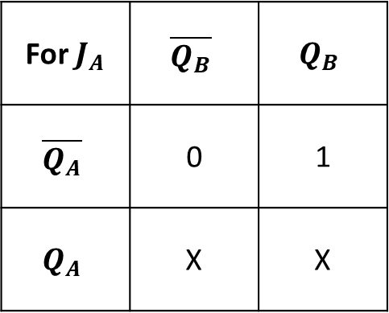
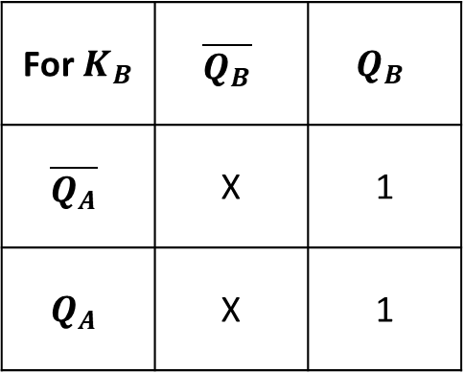
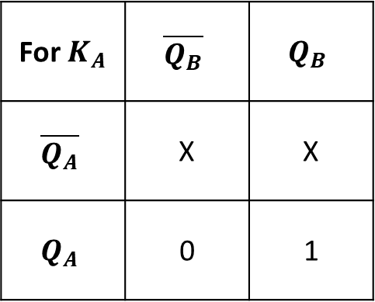
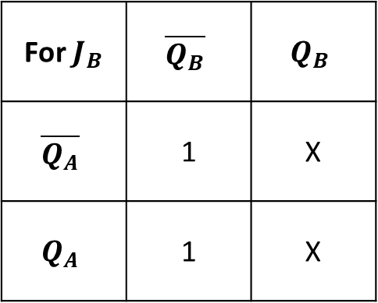
Sample 2
Designing a Counter
3. Use K-maps to find out simplified equations
For all 4 inputs, we require 4 K-maps.
For $J_{A}$ | $$\overline{Q_{B}}$$ | $$Q_{B}$$
$$\overline{Q_{A}}$$ | 0 | 1
$$Q_{A}$$ | X | X
For $J_{B}$ | $$\overline{Q_{B}}$$ | $$Q_{B}$$
$$\overline{Q_{A}}$$ | 1 | X
$$Q_{A}$$ | 1 | X
For $K_{A}$ | $$\overline{Q_{B}}$$ | $$Q_{B}$$
$$\overline{Q_{A}}$$ | X | X
$$Q_{A}$$ | 0 | 1
For $K_{B}$ | $$\overline{Q_{B}}$$ | $$Q_{B}$$
$$\overline{Q_{A}}$$ | X | 1
$$Q_{A}$$ | X | 1
The equations will be: $J_{A}=Q_{B}$, $J_{B}=1$, $K_{A}=Q_{B}$, and $K_{B}=1$

Slide 19
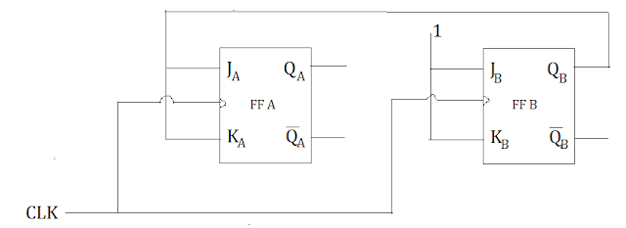
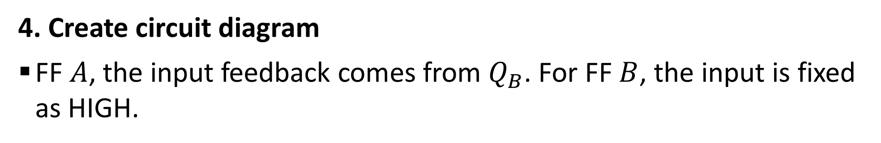
Sample 2
Designing a Counter
4. Create circuit diagram
FF $A$, the input feedback comes from $Q_{B}$. For FF $B$, the input is fixed as HIGH.

Slide 20
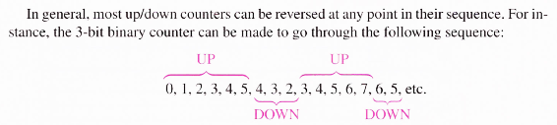
Sample 2
Up/Down Counters
Up/Down counters are bi-directional counters which can count in ascending order (0, 1, 2, 3, 4, 5, 6, 7) as well as descending order (7, 6, 5, 4, 3, 2, 1, 0).
Mostly, the Up/Down counters can be reversed at any point.

Slide 21
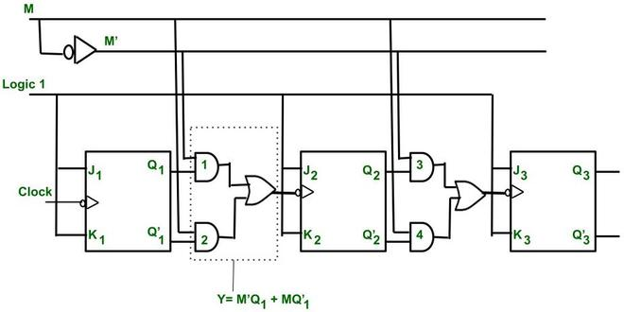
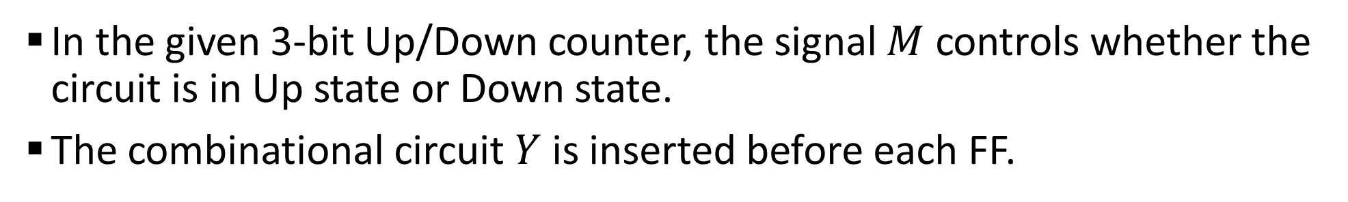
Sample 2
Up/Down Counters
In the given 3-bit Up/Down counter, the signal $M$ controls whether the circuit is in Up state or Down state.
The combinational circuit $Y$ is inserted before each FF.

Slide 22
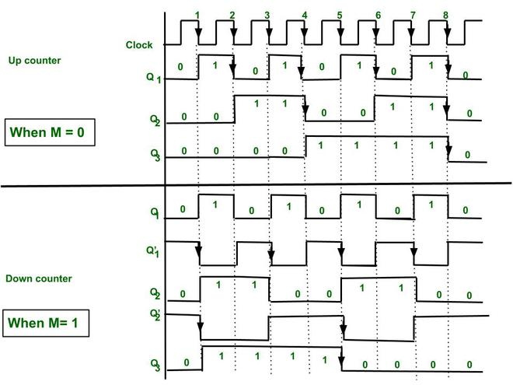
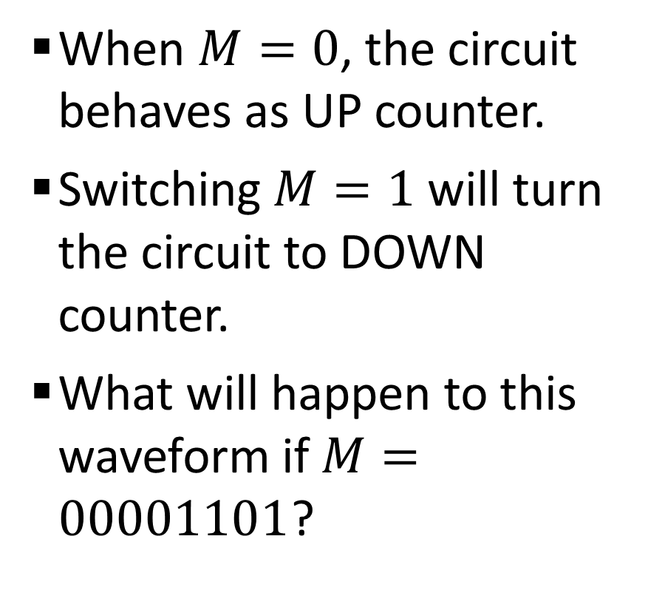
Sample 2
Up/Down Counters
When $M=0$, the circuit behaves as UP counter.
Switching $M=1$ will turn the circuit to DOWN counter.
What will happen to this waveform if $M=00001101$?

Slide 23



THANK YOU
Owais Hussain
+92 345-3174270
owais.hussain@kiet.edu.pk
https://www.researchgate.net/profile/Owais-Hussain-3

